Slide 1

Internship Report-18ECP112L
Name-KAVIN A S
Register No-RA1911004010008
Department/Section - ECE/A
College-SRM Institute of Science and Technology
Campus - Kattankulathur

Slide 2
Index
Presentation Outline
About The Organization
Description about internship
Certificate
Title of Project
Brief About Experience Gained
Conclusion

Slide 3
Presentation Outline
I have been part of the R&D team as Data Engineer and worked under the domains of Machine Learning , IOT etc.,
A spoofing attack happens when someone tries to impersonate someone else by fabricating data in order to obtain unauthorized access and advantages.
Automatic number-plate recognition (ANPR) is a technology that uses optical Character Recognition on images to read vehicles registration plate to create Vehicle Location Data.

Slide 4
About The Organization
I completed my internship with Kriti Labs in Chennai, which offers a platform for learning the fundamentals and applying concepts to real-world issues. I spent three months working as an intern. Regarding the company's objective, vision, and purpose
Mission: To provide solutions in areas of security, process enforcement and compliance management to different industries thereby helping them to improve the productivity of their assets.
Vision: Add value in every human endeavor that is limited either by geography or process complexity.
Purpose: Value addition through digital transformation.

Slide 5
Description about Internship
I have worked in Anti Spoofing face in live. Worked on face recognition and the Firmware team was very helpful and they helped me out in every point of time.Anti Spoofing face model detects the Original Human face in live.
I have worked on ANPR on Data annotation and data cleaning. This annotated data is then used for model training. Data annotation is the process of labeling individual elements of training data (whether text, images, audio, or video) to help machines understand what exactly is in it and what is important.

Slide 6
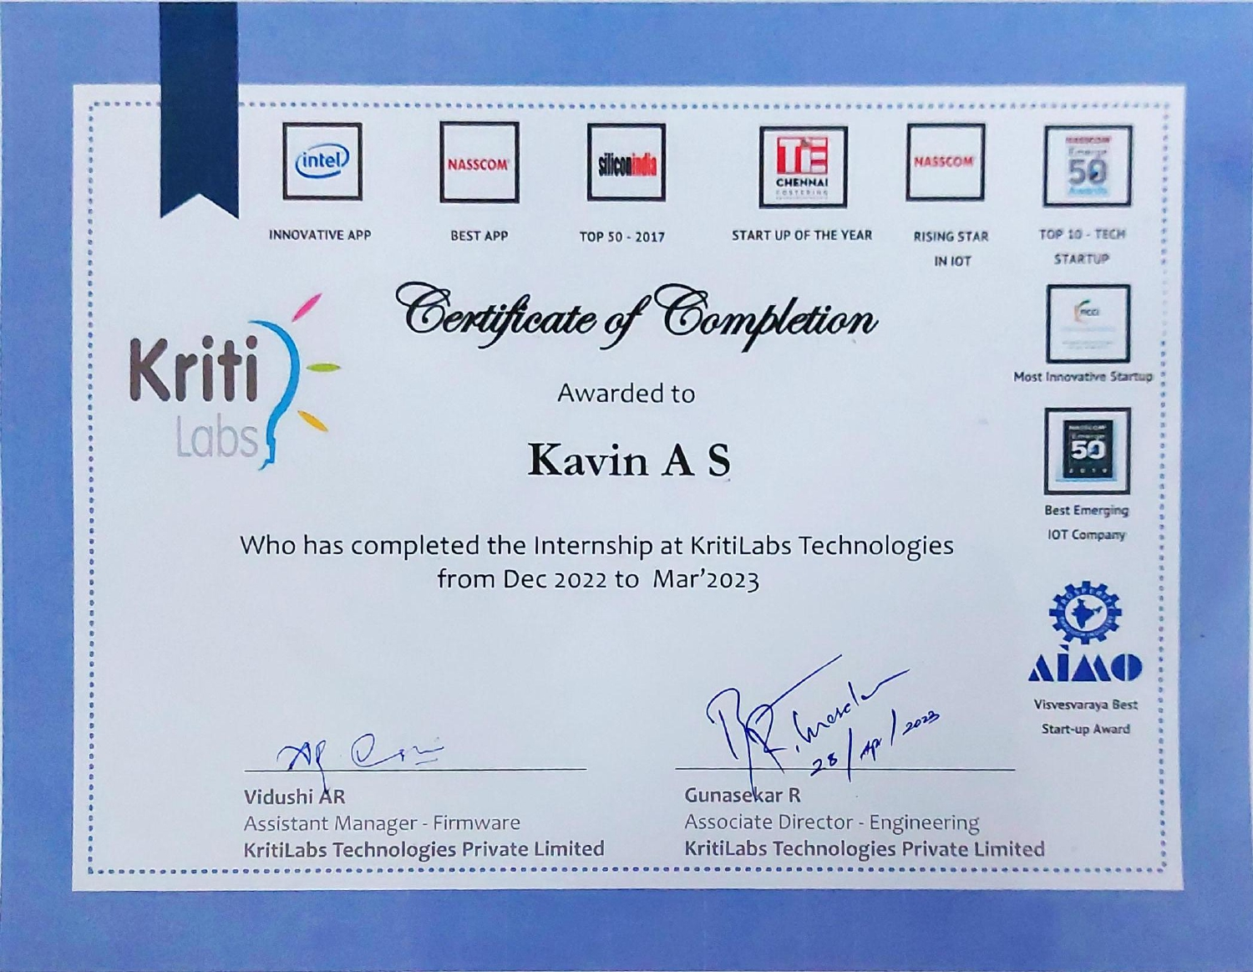
Certificate

Slide 7
Spoof Detection on Human Face
A spoofing attack happens when someone tries to impersonate someone else by fabricating data in order to obtain unauthorized access and advantages. By placing a photo, video, mask, or 3D model of the intended subject in front of the camera, for instance, one might fool a facial recognition system. Although one can also spoof with makeup or plastic surgery, since it's so simple to acquire and capture facial images, photographs are probably the most prevalent source of spoofing attacks.
Face recognition technologies are now used by many types of institutions, including the Unique Identification Authority of India (UIDAI), which provides identity to all Indian citizens. Access control using face biometrics is widespread and does not just apply to passwords on mobile devices or gaming consoles like the Xbox. Automatic face recognition systems are employed by Uber's driver verification procedure, AirBnB's requirement for user face profiles, etc

Slide 8
Spoof Detection on Human Face
Thus, in order to prevent the attack, we created a model that can distinguish between a real face and a fake one.
Face detection: In the initial step, we created a model using OPEN CV that can identify a person's face in a photograph, a video, or a LIVE broadcast.
Machine learning: I have calibrated how to distinguish between the Original Face and the Spoofed Face in the second stage.
Transfer Learning: In response to the calibration, I created a machine learning model called Transfer Learning that will distinguish between the real face and a faked one.
Liveness Net: As the last phase in the process, I created an OPEN CV Model and implemented the Transfer Learning Model in it

Slide 9
AUTOMATIC NUMBER PLATE RECOGNIZATION
Automatic number-plate recognition (ANPR) is a technology that uses optical character recognition on images to read vehicle registration plates to create vehicle location data . It can use existing closed-circuit television , road-rule enforcement cameras , or cameras specifically designed for the task. ANPR is used by police forces around the world for law enforcement purposes, including to check if a vehicle is registered or licensed . It is also used for electronic toll collection on pay-per-use roads and as a method of cataloguing the movements of traffic by highways agencies.
Automatic number-plate recognition can be used to store the images captured by the cameras as well as the text from the license plate, with some configurable to store a photograph of the driver. Systems commonly use infrared lighting to allow the camera to take the picture at any time of day or night.

Slide 10
AUTOMATIC NUMBER PLATE RECOGNIZATION
DATA ANNOTATION:
Data annotation is the process of labeling individual elements of training data (whether text,images, audio, or video) to help machines understand what exactly is in it and what is important.
This annotated data is then used for model training.
Data annotation also plays a part in the larger quality control process of data collection, as well—annotated datasets become ground truth datasets: data that is held up as a gold standard and used to measure model performance and the quality of other datasets.

Slide 11
AUTOMATIC NUMBER PLATE RECOGNIZATION
DATA CLEANING:
Data cleaning is the process of fixing or removing incorrect, corrupted, incorrectly formatted,duplicate, or incomplete data within a dataset.
When combining multiple data sources, there are many opportunities for data to be duplicated or mislabeled.
If data is incorrect, outcomes and algorithms are unreliable, even though they may look correct.

Slide 12
Components Used
Pycharm IDE
Machine Learning
IP camera
Lableme

Slide 13
Experience Gain
This internship helped me to grow professionally and personally. On professional front I learned many technical skills like in, ML, Data Annotation, Data Cleaning, DOT Board soldering, implementation of Arduino UNO, Raspberry PI, IR Sensor and core knowledge. This internship provided me a new learning opportunity in field of technology of Hardware and Firmware.

Slide 14
Conclusion
Hence I have implemented the my idea to detect the spoofed face and ANPR successfully with the help of my Guide who have keep encouraging and Implementing new Ideas. I have successfully completed my Internship with their guidance.

Slide 15
THANK YOU

